Slide 1


Advanced Computer Architecture Fall 2020
Hamed Farbeh
farbeh@aut.ac.ir
Department of Computer Engineering and Information Technology
Amirkabir University of Technology
Lecture 7

Slide 2
Copyright Notice
Lectures adopted from
Computer Architecture: A Quantitative Approach, 5th edition, John L. Hennessy,‎ David A. Patterson, MK pub., 2019
Advanced Computer Architecture-Fall 2020, AUT, Tehran, Iran

Slide 3
Computer Architecture
A Quantitative Approach, Sixth Edition
Chapter 5
Thread-Level Parallelism

Slide 4
Introduction
Introduction
Thread-Level parallelism
Have multiple program counters
Uses MIMD model
Targeted for tightly-coupled shared-memory multiprocessors
For n processors, need n threads
Amount of computation assigned to each thread = grain size
Threads can be used for data-level parallelism, but the overheads may outweigh the benefit

Slide 5
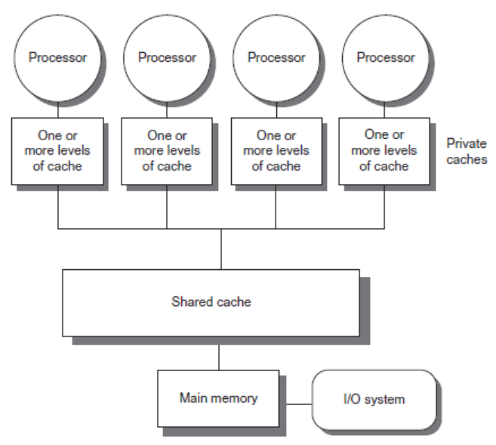
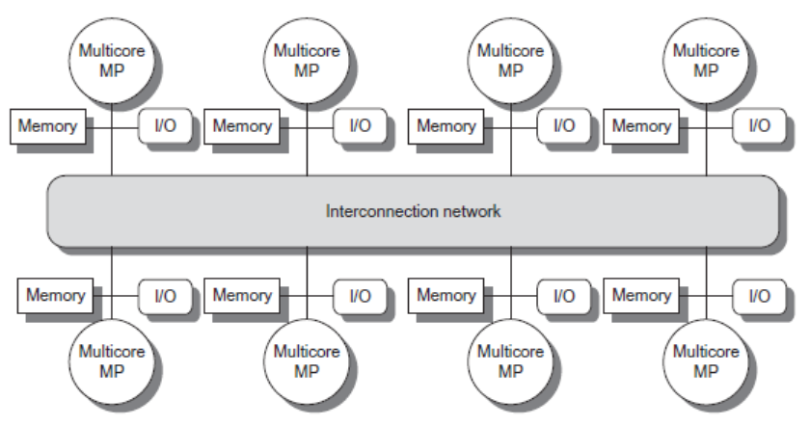
Types
Introduction
Symmetric multiprocessors (SMP)
Small number of cores
Share single memory with uniform memory latency
Distributed shared memory (DSM)
Memory distributed among processors
Non-uniform memory access/latency (NUMA)
Processors connected via direct (switched) and non-direct (multi-hop) interconnection networks

Slide 6
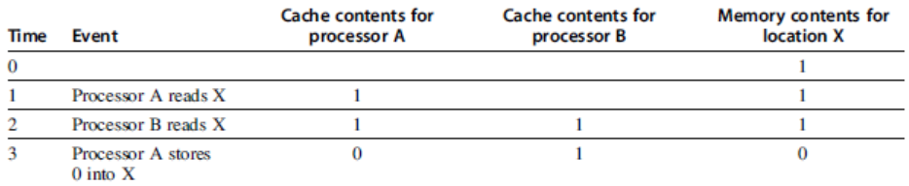
Cache Coherence
Processors may see different values through their caches:
Centralized Shared-Memory Architectures

Slide 7
Cache Coherence
Coherence
All reads by any processor must return the most recently written value
Writes to the same location by any two processors are seen in the same order by all processors
Consistency
When a written value will be returned by a read
If a processor writes location A followed by location B, any processor that sees the new value of B must also see the new value of A
Centralized Shared-Memory Architectures

Slide 8
Enforcing Coherence
Coherent caches provide:
Migration: movement of data
Replication: multiple copies of data
Cache coherence protocols
Directory based
Sharing status of each block kept in one location
Snooping
Each core tracks sharing status of each block
Centralized Shared-Memory Architectures

Slide 9
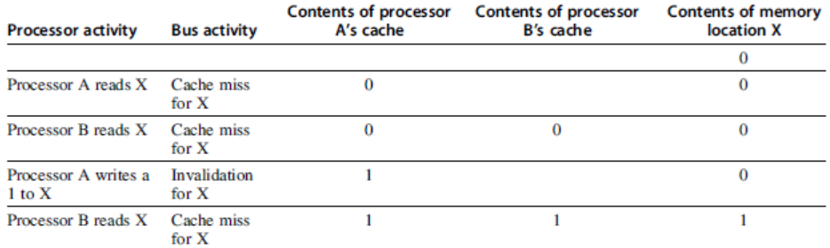
Snoopy Coherence Protocols
Write invalidate
On write, invalidate all other copies
Use bus itself to serialize
Write cannot complete until bus access is obtained
Write update
On write, update all copies
Centralized Shared-Memory Architectures

Slide 10
Snoopy Coherence Protocols
Locating an item when a read miss occurs
In write-back cache, the updated value must be sent to the requesting processor
Cache lines marked as shared or exclusive/modified
Only writes to shared lines need an invalidate broadcast
After this, the line is marked as exclusive
Centralized Shared-Memory Architectures

Slide 11
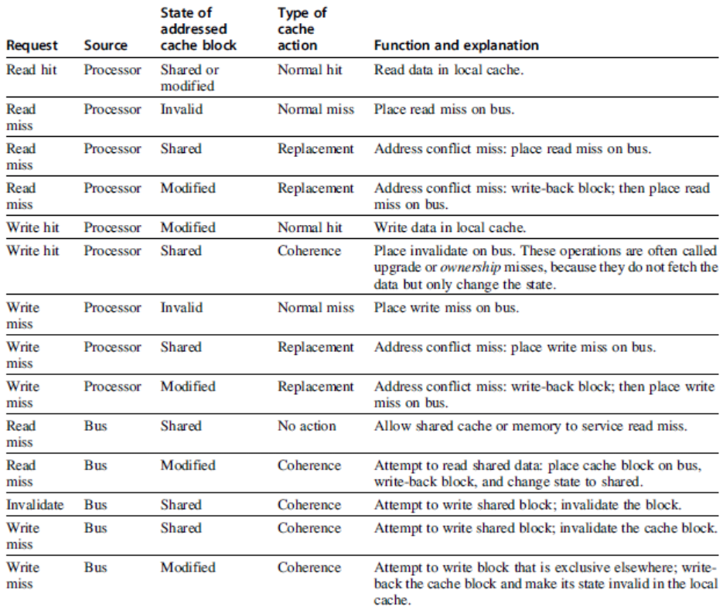
Snoopy Coherence Protocols
Centralized Shared-Memory Architectures

Slide 12
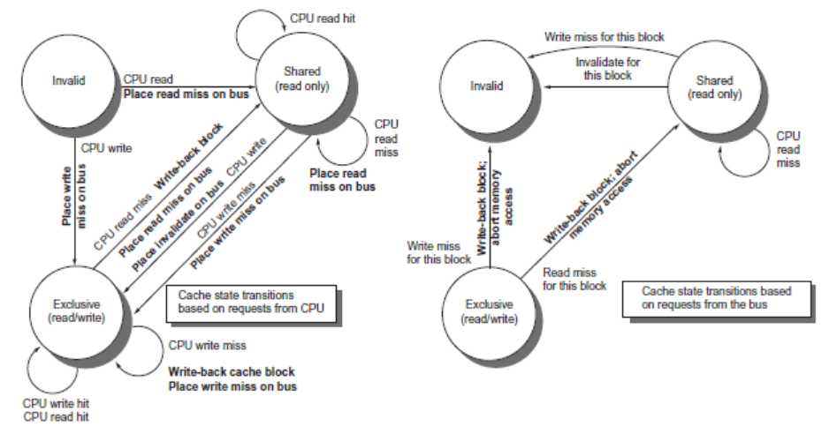
Snoopy Coherence Protocols
Centralized Shared-Memory Architectures

Slide 13
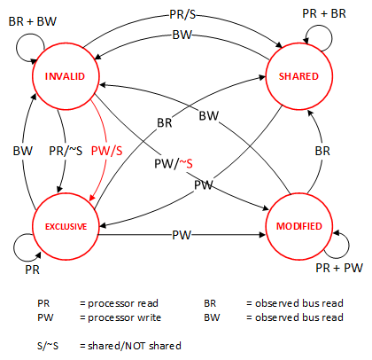
MESI Protocol
Centralized Shared-Memory Architectures
write

Slide 14
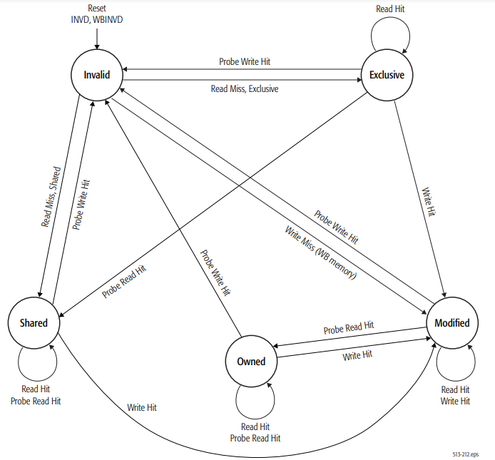
MOESI Protocol
Centralized Shared-Memory Architectures
write

